Slide 1
PIN BANK OF VASAVI --dept.of IT
Mini project of presentation

Slide 2

VASAVI COLLEGE OF ENGINEERING DEPARTMENT OF IT
TEAM MEMBERS DETAILS:-
TEAM MEMBERS | HALL TICKET NO.
Pavan kumar reddy | 1602-21-737-159
Siliveri nandini | 1602-21-737-154

Slide 3
ABSTRACT
This project is entitled PIN BANK OF VASAVI . This project based BANKING SYSTEM,it AIMs to create secure banking for student of vasavi.
This web application is to solve some problems of students in our college. minor students who don’t have bank account and who are not eligible to access upi can do money transaction in our website safely and secure.
During tiffins time ,lunch time so much rush will be there at the place where we buy tokens and where we take our order .same problem is there at the juice point and stationary shops in our college. time waste and in most of cases we return without taking our orders.
If we buy our tokens online we no need not to fight to buy tokens at the counter.Canteen’s boys who prepare our orders will get to know how many orders they have to prepare and that many number of orders will be prepared, we just go and show our token ,then he will give us item what we have bought on that token.
This is same with the stationary and canteen.

Slide 4
IMPLEMENTATION
This simple banking System can be accessed by 2 different user roles which are administrators and the students. The administrator can access the admin panel of the system while the students has access to student ID of application.
The Administrator user is the one who is in charge of managing the important data on the system. This side of the system requires the Admin User to log in with his/her valid system credentials in order to access and manage the system on the admin side. Here, the administrator is able to read and manage the quotation requests of the student and the same as well on the created or who has already account in it.. Aside from that, the admin can also list the registered students' accounts.

Slide 5
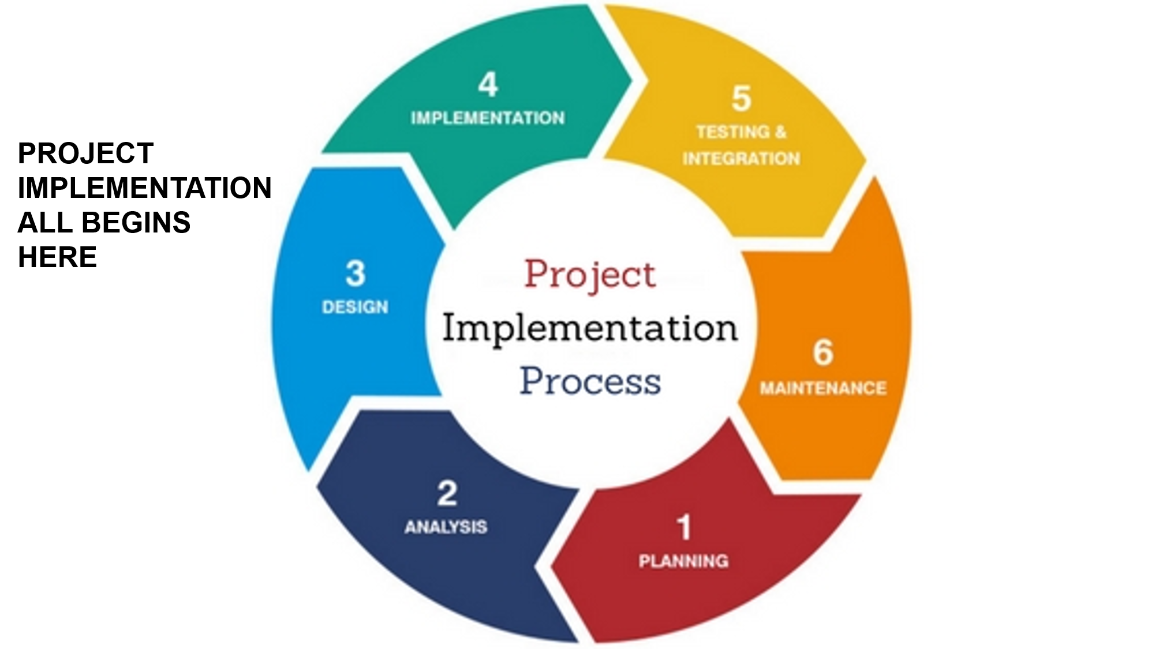

The students are required to signup and log in to the system in order to gain access to the different features and functionalities on the student account. They can transfer money to their classmates and clgmates only by using ones roll no. and course. The students can only access and manage the list of orders and transcantions that he or she did.

Slide 6
PSEUDO ALGORITHM
Start.
Creation of student account by giving personal details.
login to our account with roll number and pas.
Account will be open . we can have following services on click.
4.1. On clicking on “Money transfer” we can send money to our friends.
4.2. On clicking “canteen” we can see items and buy them they will be added to our order section .Orders will be sent to canteen.
4.3 On clicking “stationary” we can see and buy stationary items they will be added to our orders and orders will sent to stationary shop.
4.4 On clicking “juice point” we can see and buy juicepoint items they will be added to our orders and orders will sent to juicepoint shop.
4.5 on clicking orders we can see our orders in different sections.
5.exit.

Slide 7
REQUIREMENTS:---
HARDWARE REQUIREMENTS
512 MB RAM
2GB HDD
SOFTWARE REQUIREMENTS
Windows operating system
Vs code
Mongodb access

Slide 8
WEB PAGES
2.STUDENT LOGIN
3.MONEY TRANSFER
4.CAFE,STATIONERY
JUICE POINT
5.ORDERS & HISTORY
1.Signup

Slide 9
Features and Functionalities
ADMIN SITE:
Login and Logout
Dashboard: Data Summary and Visitors
ORDER HISTORY
HISTORY RECIEVED
TRANSFER
Update/Change Passwords

Slide 10
STUDENT’S SITE:
Login and Registration
Dashboard
ORDERS AVAILABLE
BALANCE
TRANSFER(PAY)
HISTORY
Update/Change Password

Slide 11
ADVANTAGE :
Easy to transfer money to others.
Buy items in college stores from any where .
Minors can use upi and online bank services.
No need to struggle at the rush to buy any item.
Time saving .Free of cost.
Your orders will be prepared and packed when we have bought in our respective stores , you no need to wait for our orders.

Slide 12

LANGUAGES USED
HTML
CSS
JAVA SCRIPT,Node.js
Mongodb
Database
React.js

Slide 13
CONCLUSION:
We had implemented web application in which students can get an account by college details .It is easy to use and simple .It can easily understood by students. Students can transfer money within fraction of seconds safely . Students can buy items which are available in our college at different stores . We just go there and redeem your token and get items.

Slide 14
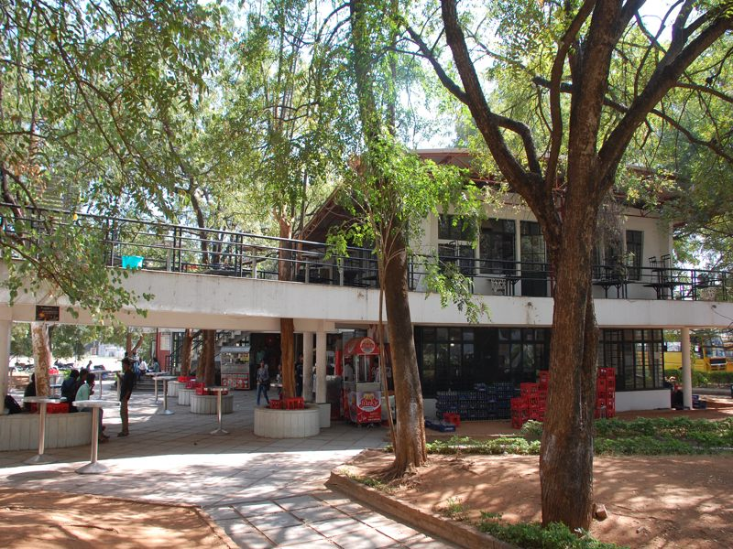
THANK YOU.

